Slide 1

PowerShell User Group
Southampton 24/10/2019
@PSSouthampton

Slide 2
agenda!
7.00pm - Arrival
7.15pm - Welcome / User Group Introduction - @jonathanmedd
7.30pm - Chef Habitat & PowerShell: Build, deploy and manage all applications the same way. Part 1 - @Dan1el42
8.15pm - Break / Pizza / Refreshments
8.45pm – Chef Habitat & PowerShell: Build, deploy and manage all applications the same way. Part 2 - @Dan1el42
9.30pm - Wrap up / Close

Slide 3
Welcome and Practicalities
Fire exits
Respect our hosts
Deposit and Public Liability Insurance is on me
THANK YOU!

Slide 4

SPONSOR

Slide 5
SANDERSON – Current Vacancies
Current vacancies with:
Kingfisher
Carnival
Old Mutual
Vitality
For more info, chat to Hannah during the break or
Hannah.Waddington@sandersonplc.com

Slide 6
User Group
Aim to meet roughly every 1 – 2 months
In 2019 we have met Jan – Mar, May – Jun, Sep - Oct
Tuesday Nov 26th – Will Tomlinson
Working on dates for Jan – Mar 2020

Slide 7
Want to present?

Slide 8
We need!
Speakers
Some lined up, discussions ongoing
Topic ideas – we need to know what you want to hear about
Leave your session volunteering details on the cards

Slide 9
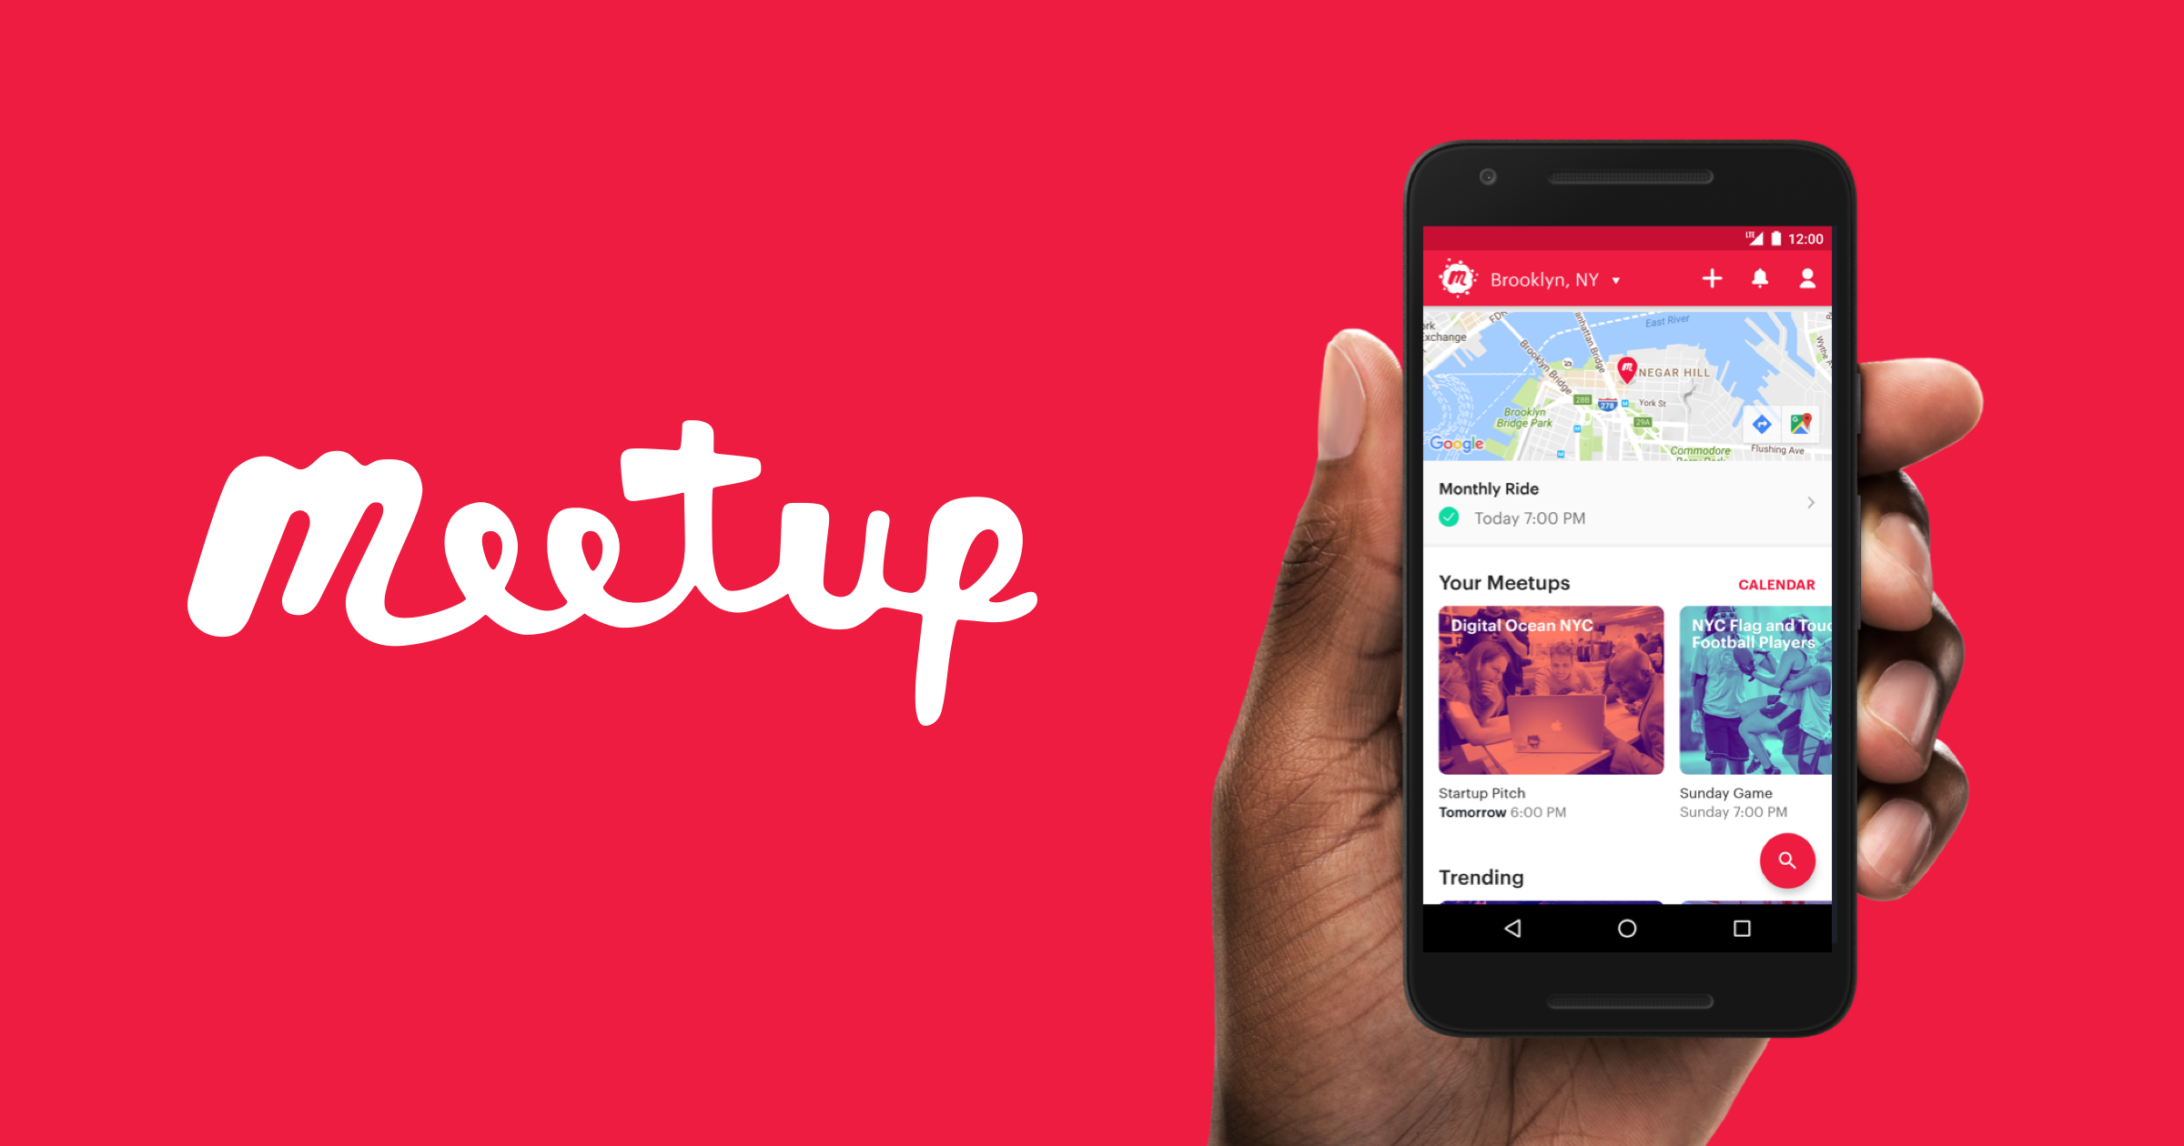
Communication
Meetup.com - https://www.meetup.com/PowerShell-Southampton
Twitter - https://twitter.com/PSSouthampton
Slides and content will appear here: https://github.com/powershellorguk/SouthCoast

Slide 10
RSVP Please

Slide 11
Hurry up and move on!

